Slide 1
Claim Setup Rules
29 August 2011
Notes:
Claim Setup Rules - <number>
Guidewire training materials contain Guidewire proprietary information that is subject to confidentiality and non-disclosure agreements. You agree to use the information in this manual solely for the purpose of training to implement Guidewire software solutions. You also agree not to disclose the information in this manual to third parties or copy this manual without prior written consent from Guidewire. Guidewire training may be given only by Guidewire employees or certified Guidewire partners under the appropriate agreement with Guidewire.

Slide 2
Lesson objectives
By the end of this lesson, you should be able to:
  Describe how claim setup rules execute claim setup
  Write presetup rules
  Write segmentation rules
  Write workplan rules
  Manage activity patterns
  Describe the rules executed for exposure and activity setup
  This lesson uses the notes section for additional explanation and information.
  To view the notes in PowerPoint, choose View→Normal or View→Notes Page.
  If you choose to print the notes for the lesson, be sure to select “Print hidden slides.”
Notes:
Claim Setup Rules - <number>

Slide 3
Lesson outline
Claim setup basics
Presetup rules
Segmentation rules
Workplan rules
Exposure and activity setup
Notes:
Claim Setup Rules - <number>

Slide 4
The intake process: automated claim setup:
Business view
Claim is entered in New Claim Wizard
Automated Claim Setup
Create and assign activities
Segment
claim
Assign
claim
Validate
claim
import
Rules triggered by claim import or completion of new claim wizard
Prepare claim for adjudication
Claim is entered in external
FNOL application
Notes:
Introduction to Claim Intake - <number>
Once the claim has been created or imported, it enters the automated claim setup process. There are three primary things that occur during claim setup. First, the claim is segmented. Segmentation is the process of determining the strategy for how the claim should be processed. (For example, is the claim straight-forward or is it complex and will it require adjusters with special expertise.) Then, the claim is assigned. Assignment is the act of determining who is responsible for the claim. The user creating the claim can specify who it should be assigned to, or the assignment could be determined using automated rules. Finally, a series of activities known as the "workplan" are created and assigned. These activities identify the work that must be done to process the claim and who must do it.
Claim setup is run only when the NCW completes, or when you call the addFNOL() method from the web services API. You cannot invoke setup from rules.

Slide 5
Automated claim setup
Automated Claim Setup
Create and assign activities
Segment
claim
Assign
claim
A series of rules designed to:
  Execute any work required for the claim that can be done automatically (such as generating a list of activities to complete)
  Ensure that the claim is ready for adjudication
  Sometimes referred to as “SAW”
    Segment
    Assign
    Workplan
Notes:
Introduction to Claim Intake - <number>

Slide 6
The intake process: automated claim setup:
Configurator view
Claim is entered in New Claim Wizard
Preupdate + validate
claim
Automated Claim Setup
Presetup
Create and assign activities
Postsetup
Initial
Reserve
Segment
claim
Assign
claim
import
Loaded
Rules triggered by claim import or completion of new claim wizard
Prepare claim for adjudication
Claim is entered in external
FNOL application
Notes:
Introduction to Claim Intake - <number>

Slide 7
Claim setup rules
Loaded
Series of rules executed to complete claim setup
For most rules, there are both Claim-level and exposure-level rules
  In most cases, claim-level rules run before exposure-level rules
Presetup
  Some are exclusive to setup; others are also used outside setup
Segmentation
unique to setup
Assignment
used
outside
setup
Workplan
activity rules
Postsetup
Initial Reserve
Preupdate
Validation
Notes:
Claim Setup Rules - <number>
The only rule set which doesn't have both claim- and exposure-level rules is Initial Reserve. (These are only exposure-level rules.)
The only time claim-level rules are not run first is Segmentation. (Exposure-level segmentation rules are executed first.)
The rules engine runs all of the rule sets listed on the slide above, with the possible exceptions:
Loaded rules are executed only if the claim entered the system through an FNOL import.
Assignment rules are executed only if the user chooses to use automated assignment rules for the claim.
If the Claim Workplan rule set does not create any activities, then the activity rules (presetup, assignment, postsetup) immediately following it are not run. The same is also true for the Exposure Workplan rule set.
The rules that are executed during claim setup have been somewhat simplified in the diagram above. The next page shows the complete list of rules in the order they are executed.

Slide 8

(Notes only slide)
Notes:
Claim Setup Rules - <number>
Notes are visible if you view PowerPoint in Notes view (View | Notes Page).

Slide 9

Exposure in claim setup
Can exist at the start of setup
  Created during new claim wizard
  Imported with imported claim
Can be created during setup
  Typically in Presetup rules
May not be present at all
  If no exposures exist, exposure-level rules are skipped
imported with claim
Loaded
created in wizard
Presetup
created during
set-up
Segmentation
Notes:
Claim Setup Rules - <number>
The way in which a claim is segmented is often heavily dependent on its exposures. Therefore, if exposures are created during set-up, it typically occurs in Presetup rules, which are the rules that immediately precede segmentation.

Slide 10
Loaded rules
Claim
Exposure
Loaded
Executed only for imported claims and exposures
Purpose
  Execute actions related to import
Example
  Log information about every claim received via FNOL import
Presetup
Segmentation
Assignment
Workplan
activity rules
Postsetup
Initial Reserve
Preupdate
Validation
Notes:
Claim Setup Rules - <number>
Claim Loaded rules execute when a new claim is loaded through the FNOL import interface. ClaimCenter executes Loaded rules when it finishes importing or “loading” a claim from an external FNOL source. The purpose of this rule category is to make any changes necessary to convert initial claim data from an external format into a suitable structure for ClaimCenter. In addition, you can create Loaded rules to record the import of claims.
You can create whatever rules are appropriate to handle the import of new claims:
Sanity checks
Data aggregations and transformations
Data and naming reconciliations
Claim import logging

Slide 11
Presetup rules
Loaded
Purpose
  Execute actions that must occur at beginning of setup process, particularly before segmentation
Examples
  Create "automated" exposures where need for exposure can be inferred
    Example: If loss cause is "collision with vehicle", create vehicle collision exposure
  Set deductible status to "unpaid"
Presetup
Claim
Exposure
Segmentation
Assignment
Workplan
activity rules
Postsetup
Initial Reserve
Preupdate
Validation
Notes:
Claim Setup Rules - <number>
Presetup rules are used to take action on a claim or exposure before it is segmented. This is particularly important since the segmentation (and therefore assignment) of exposures and claims might depend on work performed in the presetup rules.

Slide 12
Segmentation rules
Loaded
Purpose
  "Segment" the object (identify high-level strategy for processing object)
Examples
  In workers' comp claim, if injury severity is "fatal", segment exposure as "complex"
  In auto claim, if auto damage is only "broken windshield", segment claim as "simple - glass"
Exposure-level rules execute before claim-level rules
Presetup
Segmentation
Exposure
Claim
Assignment
Workplan
activity rules
Postsetup
Initial Reserve
Preupdate
Validation
Notes:
Claim Setup Rules - <number>
Exposure-level segmentation is done before claim-level segmentation because claim segmentation often depends on the outcome of exposure segmentation.
Segments are high-level categorizations that are used to simplify logic in later rule sets, such as:
Assignment routing
Activity creation
Initial reserves

Slide 13
Assignment rules
Loaded
Purpose
  Assign claim to group and user
  Assign each exposure to group and user
Examples
  Assign workers' comp claim with segment "complex" to national "complex WC" group
  Assign auto claims with segment "simple - auto glass" to auto glass group in same region as insured's address
Presetup
Segmentation
Assignment
Claim
Exposure
Workplan
activity rules
Postsetup
Initial Reserve
Preupdate
Validation
Notes:
Claim Setup Rules - <number>
Assignment rules are run when a claim (or exposure) is created and the "use automatic assignment" option is chosen.
The claim is assigned first, and then its exposures. The exposure owner is not necessarily the same as the claim owner. However, unless it meets a special circumstance, each exposure is typically assigned to the same group and user as the claim.
Assignment rules are also run outside of setup when a claim or exposure is reassigned and the reassigning user selects the "use automatic assignment" option.
Assignment rules are discussed in detail in the "Assignment rules" lesson in the "CC 6.0 Application Configuration - Further Study Modules" course.

Slide 14
Contrasting segmentation and assignment
easy
medium
hard
Segmentation:
Determines the strategy for processing the object
Is done only for claims and exposures
Sets a single field on the object to a value from a predefined list
Is only done once for a given object
Assignment:
Determines the group and owner of the object
Is done for claims, exposures, activities, and matters
Associates object to group and user (chosen from existing groups and users)
Could occur many times for a given object
Notes:
Introduction to Claim Intake - <number>
The primary purpose of segmentation is to categorize a claim or exposure with regards to the strategy for processing the claim. This categorization is a simple field value. It may or may not be used by assignment rules, and it may or may not be used in other aspects of claim processing. (For example, certain line items might be written to the claim's history based on its segment, such as details to changes in the parties involved if and only if the claim has a segment of "complex").
The primary purpose of assignment is to determine the owner of an assignable object, which includes activities and matters. The assignment is two foreign keys, one pointing to an existing group and one pointing to an existing user. Assignment may or may not be based on segment.

Slide 15
Workplan rules
Loaded
Purpose
  Create initial claim workplan (list of activities for claim and each exposure)
Examples
  Create "contact insured" activity
  If owner of claim is low experience user, create "verify coverage" activity
  If claim is auto, create "scene inspection" activity
For each activity created: presetup, assignment, and postsetup rules executed
Presetup
Segmentation
Assignment
Claim
Workplan
activity rules
Exposure
Postsetup
Initial Reserve
Preupdate
Validation
Notes:
Claim Setup Rules - <number>
Workplan rules are used to create initial activities for claim or exposure. Examples might include:
Investigate accident scene (claim level)
Get police report (claim level)
Contact claimant (exposure level)
Get damage estimates for vehicle (exposure level)
Each new activity is run through its own Presetup, Assignment and Postsetup rule set.
Activities can also be created for a claim after it has completed setup. These activities also go through the activity rule sets.

Slide 16
Summary: automated claim setup
Segment
claim
easy
Assign
claim
Create and assign activities
Notes:
Introduction to Claim Intake - <number>
To summarize:
Segmentation rules segment, or determine the strategy for, the claim. The result of these rules is a segment value being assigned to the claim.
Claim assignment rules assign the claim to a group and a user in that group.
Workplan rules create a series of activities for the claim known as the workplan, and assign those activities to appropriate users.

Slide 17
Postsetup rules
Loaded
Purpose
  Execute actions that must be done at end of claim setup
Examples
  If a Fraud Review activity was created, set the Claim SIU Status field to “Under Investigation”.
Presetup
Segmentation
Assignment
Workplan
activity rules
Postsetup
Claim
Exposure
Initial Reserve
Preupdate
Validation
Notes:
Claim Setup Rules - <number>

Slide 18
Initial reserve rules
Loaded
Purpose
  Set initial reserves for existing exposures
Examples
  For low-complexity collision exposures, set reserve to $1000
No claim-level initial reserve rules
Presetup
Segmentation
Assignment
Workplan
activity rules
Postsetup
Initial Reserve
Exposure
Preupdate
Validation
Notes:
Claim Setup Rules - <number>
Initial reserve rules are discussed in detail in the documentation.

Slide 19
Preupdate and validation rules
Loaded
Purpose
  Executed for all validatable objects (including claims and exposures) whenever the object is created or changed
Preupdate rules
  Make changes or additions to object before validating and saving
Validation rules
  Reject object if data is not correct and/or coplete
Presetup
Segmentation
Assignment
Workplan
activity rules
Postsetup
Initial Reserve
Preupdate
Claim
Exposure
Validation
Notes:
Claim Setup Rules - <number>
Preupdate rules are discussed in detail in the Configuration Fundamentals course.
Validation rules are discussed in detail in the "Validation Rules" lesson.
reject() functions are never called in preupdate rules.
Changes or additions are never made in validation rules.

Slide 20
Preupdate and validation rules examples
Loaded
Preupdate example:
  Create SIU review activity if changes to claim cause it to cross fraud detection threshold
Validation example:
  Reject creation of claim if loss cause is theft and loss location's street value is null
Presetup
Segmentation
Assignment
Workplan
activity rules
Postsetup
Initial Reserve
Preupdate
Claim
Exposure
Validation
Notes:
Claim Setup Rules - <number>
Preupdate rules are discussed in detail in the Configuration Fundamentals course.
Validation rules are discussed in detail in the "Validation Rules" lesson.

Slide 21
Claim setup rules: review
Loaded
Unless noted:
  Rules at both claim level and exposure level
  Claim-level rules run first
Rules in yellow rectangles are...
Rules in orange rounded rectangles are...
Presetup
Segmentation
Exposure
Claim
Assignment
unique to setup
activity rules
Workplan
Postsetup
used outside setup
Exposure
only
Initial Reserve
Preupdate
Validation
Notes:
Claim Setup Rules - <number>

Slide 22

Discussion of setup rules
Loaded
This lesson discusses:
  Presetup
  Segmentation
  Workplan
There are separate lessons for:
  Assignment (Further Study)
  Validation
Remaining rule sets not covered in this course
Presetup
this lesson
Segmentation
this lesson
Assignment
Assignment
Workplan
this lesson
Postsetup
Initial Reserve
Financials
Preupdate
(Fundamentals)
Validation
Validation
Notes:
Claim Setup Rules - <number>
Assignment rules and Initial Reserve rules are covered in lessons included in the Further Study modules for this course.
Loaded rules are not discussed in this course for time reasons. They are well documented and relevant more for FNOL application integration than they are as configuration issues.
There is very little to say about postsetup rules. There are no special points of discussion, and the little that there is to say is well documented.
Preupdate rules are discussed in the Configuration Fundamentals course, which is a prerequisite to this course.

Slide 23
Lesson outline
Claim setup basics
Presetup rules
Segmentation rules
Workplan rules
Exposure and activity setup
Notes:
Claim Setup Rules - <number>

Slide 24
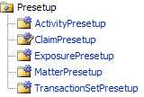
Presetup rules
Five entities have presetup rules
  Executed whenever object of that type is created
During claim setup:
  Claim presetup rules are run
  Exposure and activity presetup are run for each exposure and activity created during setup
Notes:
Claim Setup Rules - <number>

Slide 25
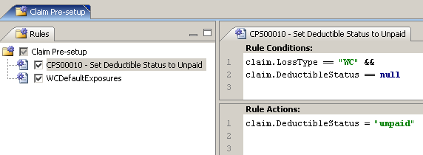
Claim presetup rules: example
If claim's loss type is workers' comp and deductible status is null, set deductible status to "unpaid"
Notes:
Claim Setup Rules - <number>

Slide 26
Lesson outline
Claim setup basics
Presetup rules
Segmentation rules
Workplan rules
Exposure and activity setup
Notes:
Claim Setup Rules - <number>

Slide 27
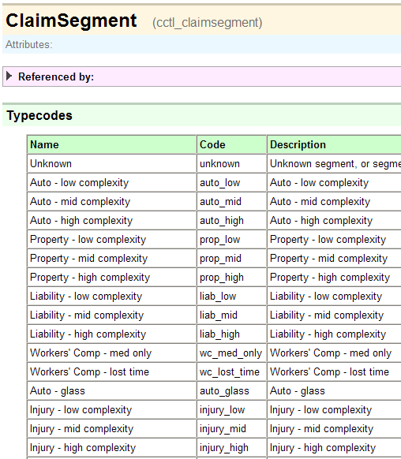
Segment fields
Segment
Segment
Notes:
Claim Setup Rules - <number>
Both the Claim and Exposure entities have a field named Segment which is a typekey to the ClaimSegment typelist.
If you want to create rules that assign or react to segments not found in the base application, you must first modify the ClaimSegment typelist. Recall that Studio caches typelist values during start-up. So if you create new segments and wish for Studio to be aware of them, you must stop and restart Studio after the typelist is extended.

Slide 28
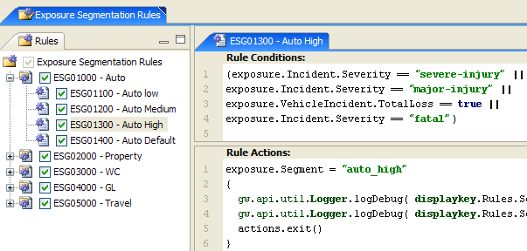
Exposure segmentation rules: example
If exposure's incident's severity is "severe-injury", "major-injury", or "fatal", or if exposure's incident is a vehicle incident which is a total loss, set segment to "auto_high"
Notes:
Claim Setup Rules - <number>

Slide 29
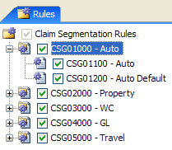
Claim segmentation rule: example (1)
for auto claims...
if exposures exist, set claim segment to highest exposure segment
otherwise, set claim segment to "auto_low"
One common practice is to set claim segment to highest exposure segment
Notes:
Claim Setup Rules - <number>

Slide 30
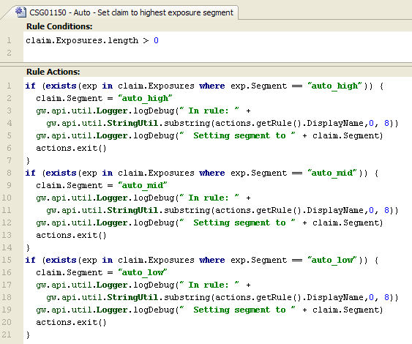
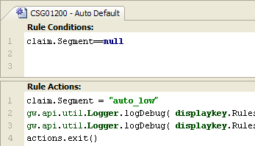
Claim segmentation rule: example (2)
if exposures exist, set claim segment to highest exposure segment
otherwise, set claim segment to "auto_low"
Notes:
Claim Setup Rules - <number>
If a claim has no exposures, then the Auto rule's Actions code will not get executed. Therefore, the claim's segment will not have been set. In these circumstances, the Auto Default rule executes.

Slide 31
Lesson outline
Claim setup basics
Presetup rules
Segmentation rules
Workplan rules
Exposure and activity setup
Notes:
Claim Setup Rules - <number>

Slide 32
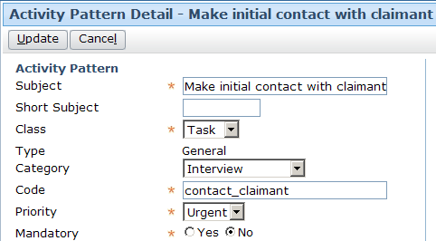
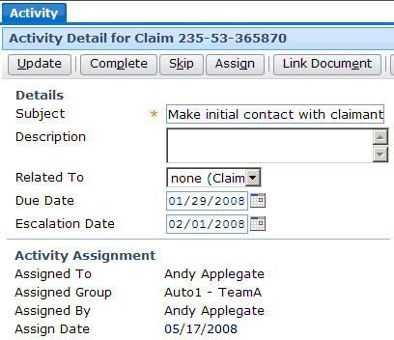
Workplan rules and activity patterns
Workplan rules create activities by referencing a pattern from which the new activity is created
Create "contact claimant" activity for this claim
Notes:
Claim Setup Rules - <number>
Before you can create a workplan rule which will create a certain type of activity, you must create the pattern for that type of activity.

Slide 33
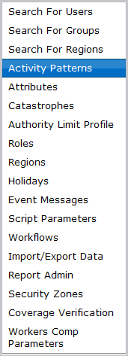
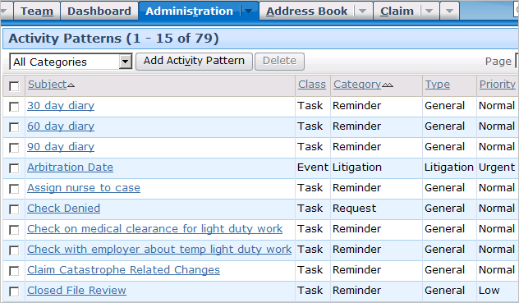
Activity patterns
administrator
Notes:
Activities - <number>
Activity patterns are typically created and modified by administrators. A user with sufficient permissions to view and edit activity patterns can navigate to the Activity Patterns list by going to the Administration tab and clicking the Activity Patterns page link.

Slide 34
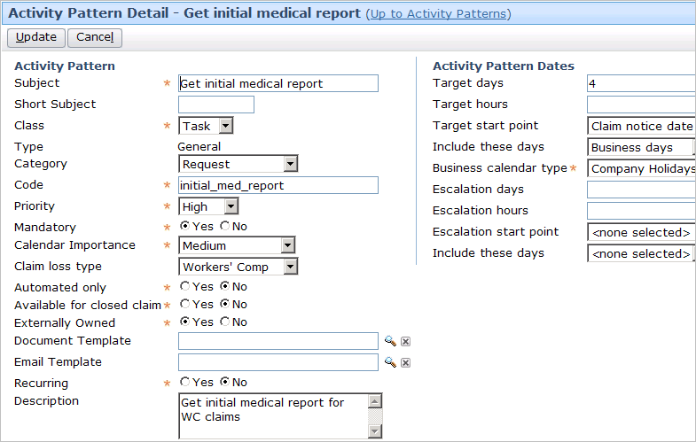
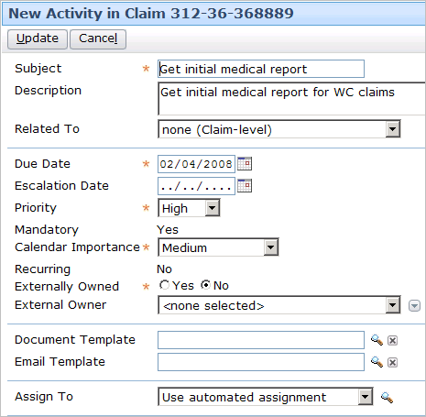
Attributes of an activity pattern
Notes:
Activities - <number>
The attributes of an activity pattern determine the behavior and default values of the activities created from it.
Many of the attributes listed above are self-explanatory. Those that are not are defined below.
Short Subject - This is a brief description of the activity used on small areas of the UI such as a calendar event entry.
Class - If the activity is a task or event. A task can have a due date whereas an event cannot.
Type - Whether the activity is a general activity (which is closed by being completed or skipped) or an approval activity (which is closed by being approved or denied).
Category - The category of the activity, which determines where in the "New Activity" page action menu the activity pattern appears.
Code - The internal name for the pattern, which is used by business rules when creating activities or checking to see which pattern an activity was created from.
Mandatory - Whether a user can skip this activity.
Claim Loss Type - The line of business for which this activity is available. (If no value is specified, it is available for claims on any line of business.)
Automated Only - Whether this pattern is hidden from manual activity creation and used only by business rules
Closed Claim Available - Whether the activity can exist on or be added to a closed claim, meaning the activity could be performed on a closed claim.
(continued)

Slide 35
(Notes only slide)
Notes:
Activities - <number>
Externally Owned - Whether the activity can be owned by an external user
Document Template - If the user should be able to create a document from a template while completing this activity, this specifies the document template to use.
Recurring - Whether the activity is likely to recur on a regular schedule. (For example, a 30 day reminder activity means that the user should check the object every 30 days.)
Description - This describes what is expected in the completion of this activity. It is visible to users only when looking at the details of the activity.
Target days/hours – The number of days/hours from the start point for the target date for activity completion
Target start point – The starting point from which the target date should be calculated. Options are activity creation date, claim loss date, and claim notice date.
Include these days – Include all calendar days or just business days.
Escalation days/hours – The number of days/hours from the start point for the escalation date for activity completion
Escalation start point – The starting point from which the escalation date should be calculated. Options are activity creation date, claim loss date, and claim notice date.
Include these days – Include all calendar days or just business days.

Slide 36
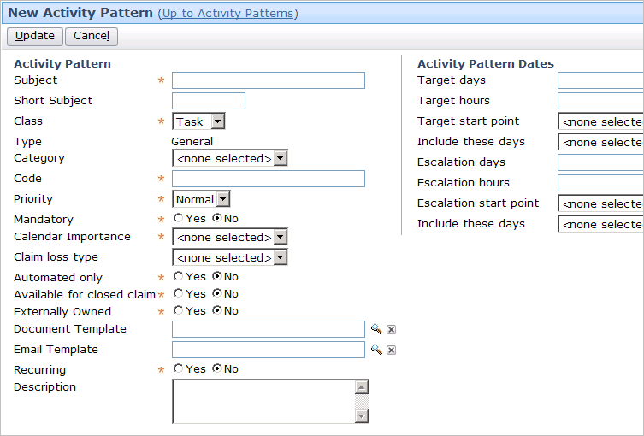
Creating new activity patterns
Notes:
Activities - <number>
To create a new activity pattern, click the Add Activity Pattern button, specify the attributes for the activity pattern, and click Update.
To edit an existing activity pattern, click the name of the activity pattern in the list. Modify the attributes as appropriate and click Update. Changes to an activity pattern affect only activities from that point forward. No changes are made to activities that have already been created from that pattern.

Slide 37
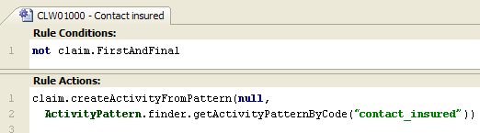
Creating activities through Gosu
Syntax:
  claim.createActivityFromPattern (
  RelatedExposure, ActivityPattern)
  claim is the current claim
  RelatedExposure is null (for claim-level activities) or the related Exposure object (for exposure-level activities)
  ActivityPattern specifies the activity pattern
Notes:
Claim Setup Rules - <number>
In the example above, an activity is created for the Claim object using the "contact_insured" activity pattern. This activity is a claim-level activity. It is not associated to any exposure.
Note that when you need to pass an ActivityPattern object to a Gosu function, you need to use the finder (as demonstrated in the rule above) to get the object by its code. The code can be found on the activity pattern admin screen (see screenshot on previous slide for example.)

Slide 38
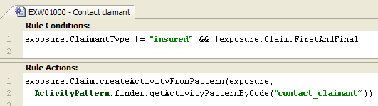
Creating activities: examples
Claim workplan rule
Exposure workplan rule
Notes:
Claim Setup Rules - <number>
In the claim workplan rule, the root object is a claim. The activity is a claim-level activity, so the first argument of the createActivityFromPattern method is null.
In the exposure workplan rule, the root object is an exposure. Therefore, the Gosu expression must navigate to the exposure's claim to reference the createActivityFromPattern method. The activity is an exposure-level activity, so the exposure is referenced in the first argument of the createActivityFromPattern method.

Slide 39


Identifying the activity pattern
Replace pattern argument with Activity pattern finder
Syntax:
  ActivityPattern.finder.getActivityPatternByCode("code")
Notes:
Claim Setup Rules - <number>
Activity patterns can also be retrieved by references to their public ID or by their ID and code. For example...
ActivityPattern(4, "contact_claimant")
ActivityPattern("default_data:10004" /*contact_claimant*/)
However, this method of retrieving activity patterns is not recommended, because it can lead to problems when ClaimCenter configurations are moved between environments.
Studio's auto-complete feature will fill in the reference to the activity pattern's public ID if you use the light bulb to select the activity pattern code, so be careful to always replace the "pattern" string with the finder, as demonstrated in the rule example above. This is the only recommended method for retrieving the activity pattern object.

Slide 40
Lesson outline
Claim setup basics
Presetup rules
Segmentation rules
Workplan rules
Exposure and activity setup
Notes:
Claim Setup Rules - <number>

Slide 41
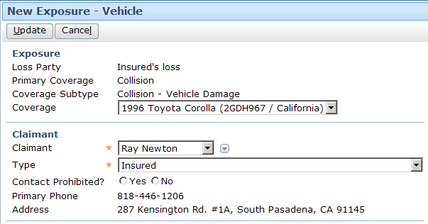
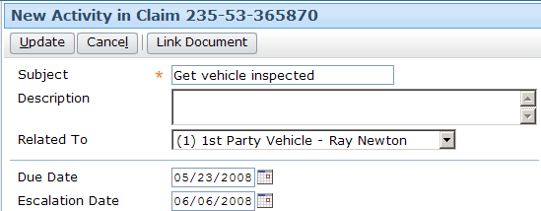
Exposure and activity setup
Claim setup only occurs at the time a claim is created
  Only once at the start of the claims process
Exposure and Activity setup occurs any time one is created
  Multiple times during the claims process
Notes:
Claim Setup Rules - <number>
Matters and transactions also have setup rules.
The rules executed for matter setup are identical to those of exposures, except matters are not segmented and have no reserves.
Transaction setup is more complex as it can vary based on the transaction type.

Slide 42
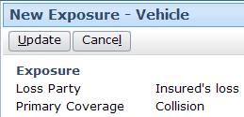
Exposure setup rules
Presetup
Segmentation
After claim setup, when an exposure is created, this series of rules is executed
  All are exposure-level
  (except the activity rules)
Assignment
Workplan
activity rules
Postsetup
Initial Reserve
Preupdate
Validation
Notes:
Claim Setup Rules - <number>
Recall that the yellow rectangles represent rules exclusive to setup. The orange rounded rectangles represent rules that are also executed outside of setup.

Slide 43

Activity setup rules
Presetup
After claim setup, when an activity is created, this series of rules is executed
  All are activity-level
  Note that activities are not segmented, have no workplan, and no reserves
Assignment
Postsetup
Preupdate
Validation
Notes:
Claim Setup Rules - <number>
Recall that the yellow rectangles represent rules exclusive to setup. The orange rounded rectangles represent rules that are also executed outside of setup.

Slide 44
Lesson objectives review
You should now be able to:
  Describe how claim setup rules execute claim setup
  Write presetup rules
  Write segmentation rules
  Write workplan rules
  Manage activity patterns
  Describe the rules executed for exposure and activity setup
Notes:
Claim Setup Rules - <number>

Slide 45
Review questions
Loaded
Which rule set does not have both claim-level and exposure-level rules?
For which rule set do exposure-level rules run before claim-level rules? Why?
What type of object is most likely to be created in presetup rules? Workplan rules?
Which claim-level rule sets are also executed outside of claim setup? For each, give a non-claim setup example of when they might run.
What rule sets are in "activity rules"?
Presetup
Segmentation
Assignment
Workplan
activity rules
Postsetup
Initial Reserve
Preupdate
Validation
Notes:
Claim Setup Rules - <number>
Answers
1. Initial Reserve, which have only exposure-level rules.
2. Segmentation. Exposure-level rules are run first because claim segmentation often depends upon the outcome of exposure segmentation.
3. Exposures. Activities.
4. Assignment - When a claim is reassigned using assignment rules.
Preupdate - When a claim is modified.
Validation - When a claim is modified.
"activity rules" – Whenever a new activity is created.
5. Activity Presetup, Activity Assignment, Activity Postsetup

Slide 46
Notices
Copyright © 2001-2011 Guidewire Software, Inc. All Rights Reserved.
Guidewire, Guidewire Software, Guidewire ClaimCenter, Guidewire PolicyCenter, Guidewire BillingCenter, Guidewire Reinsurance Management, Guidewire ContactManager, Guidewire Vendor Data Management, Guidewire Client Data Management, Guidewire InsuranceSuite, Guidewire ContactCenter, Guidewire Studio, Gosu, Deliver Insurance Your Way, and the Guidewire logo are trademarks or registered trademarks of Guidewire Software, Inc. in the United States and/or other countries.
This material is Guidewire proprietary and confidential. The contents of this material, including product architecture details and APIs, are considered confidential and are fully protected by customer licensing confidentiality agreements and signed Non-Disclosure Agreements (NDAs).
This file and the contents herein are the property of Guidewire Software, Inc. Use of this course material is restricted to students officially registered in this specific Guidewire-instructed course, or for other use expressly authorized by Guidewire. Replication or distribution of this course material in electronic, paper, or other format is prohibited without express permission from Guidewire.
    Guidewire products are protected by one or more of the following patents: U.S. Patent No. 7,885,831; U.S. Patent No. 7,788,296.
Notes:
Introduction to Guidewire Configuration - <number>

